Slide 1

Performance Management

Slide 2


Team Member
Sujit Patil
Raj Kasat
Suraj Mesharam
Kiran Musale

Slide 3

Definition
Performance management is an ongoing process of communication between a supervisor and an employee that occurs throughout the year, in support of accomplishing the strategic objectives of the organization. The communication process includes clarifying expectations, setting objectives, identifying goals, providing feedback, and reviewing results
An effective performance management process, while requiring time to plan and implement, can save you and the employee time and energy. Most importantly, it can be a very effective motivator, since it can help you and the employee achieve organizational success.

Slide 4

There are three phases:
Phase 1: Planning
Phase 2: Check-In
Phase 3: Review

Slide 5

An effective performance management process sets the foundation aligning the individual's efforts with the university's goals.
By linking individual employee work efforts with the organization’s mission and objectives, the employee and the organization understand how that job contributes to the organization.
By focusing attention on setting clear performance expectations (results + actions & behaviors), it helps the employee know what needs to be done to be successful on the job.
Using objectives, standards, performance dimensions, and other measures it focuses effort. This helps the department get done what needs to be done and provides a solid rationale for eliminating work that is no longer useful.
Through regular check-in discussions, which include status updates, coaching, and feedback, it promotes flexibility, allowing you and the employee to identify problems early and change the course of a project or work assignment.

Slide 6

Performance Management Tools
Trakstar
Eden
PerformYard
Primalogik
Monday.com

Slide 7
Trakstar
Trakstar helps your organization manage performance reviews, employee engagement surveys, 360-degree/multi-rater feedback, and goals across hundreds or thousands of employees.
You can also build customized appraisal forms, set SMART goals, and create flexible workflow processes to meet the needs of your organization.
Trakstar integrates with Google Workspace, Okta, and OneLogin.

Slide 8

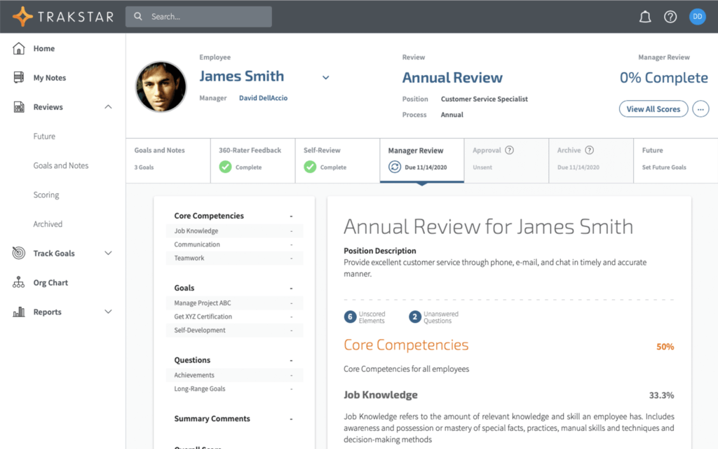

Slide 9

Characteristics of an Effective Performance Management System
There are many different types of performance management systems that can be used within organizations, but every effective system will include these 4 characteristics:
It must be Fair
It must be Ongoing
It must be carefully Documented
It must be Aligned with Organizational Culture and Values

Slide 10

Directive style
What is directive Style leadership?
It is one of four leadership behaviors that sets clearly defined objectives and rules for team members.
Under directive leadership, managers must guide employees' work goals and establish the path by which they can achieve those goals.
For example, directive leaders may provide guidance and coaching, clarify an employee's roles and responsibilities, remove any obstacles that prevent completion of tasks and give awards when appropriate.

Slide 11

Benefits of directive leadership
Every task and process is structured
Security and Safety of Company assets are ensured
Clarity within roles
Simplifying learning
Accountability

Slide 12

Collaborative Style
What is collaborative Style leadership?
This is a more contemporary style of management where the owner or manager consults with sales staff and builds relationships with them, encouraging them to offer their opinion and point of view to the goings on in the office.
They also allow the staff to be creative with their approach and have input into whatever they do. Owners and managers still have some control, but decisions are made after collaborating with the individual or team. This helps gain many different points of view and can be very powerful when done correctly.

Slide 13

Benefits of collaborative leadership
A shared sense of organization’s purpose
Closer teams who understand how their work intersects with and influences other teams across the organization
A more interconnected, up-to-date and engage workforce
An org-wide sense that leaders trust their people to do great work
Increases employee loyalty

Slide 14

Deloitte – Case Study
In 2015, Deloitte was the first big name to announce it was scrap­ping once-a-year per­for­mance reviews, 360-degree feed­back. This change occurred after the com­pa­ny cal­cu­lat­ed these process­es were con­sum­ing a remark­able two mil­lion hours a year across the organization.
Deloitte’s new per­for­mance man­age­ment process requires every team leader to check in with each team mem­ber once a week to dis­cuss near-term SMART goals and pri­or­i­ties, com­ment on recent work and pro­vide coach­ing. The check-ins are ini­ti­at­ed by the team mem­bers, rather than the team lead­ers to ensure these check-ins take place fre­quent­ly. This also serves to give employ­ees a sense of own­er­ship over their work, role and time
These week­ly employ­ee check-ins are sup­port­ed by quar­ter­ly reviews when team lead­ers are asked to respond to four future-focused state­ments about each team mem­ber. Rather than ask­ing team lead­ers what they think of the team mem­ber — which is what tra­di­tion­al per­for­mance rat­ings do — they ask what the team leader would do with the team member.

Slide 15

References
https://peoplemanagingpeople.com/tools/performance-management-tools/
https://hr.berkeley.edu/hr-network/central-guide-managing-hr/managing-hr/managing-successfully/performance-management/concepts#:~:text=Performance%20Management%20%2D%20Definition,strategic%20objectives%20of%20the%20organization.
https://www.clearreview.com/top-5-performance-management-case-studies/

Slide 16


